Slide 1
kieso
weygandt
warfield
INTERMEDIATE
ACCOUNTING
Intermediate Accounting
team for success
F I F T E E N T H E D I T I O N
Intermediate Accounting
2014 FASB Update
Chapter 18
Revenue Recognition
Prepared by
Coby Harmon
University of California, Santa Barbara
Westmont College
Prepared by
Coby Harmon
University of California, Santa Barbara
Westmont College
Prepared by
Coby Harmon
University of California, Santa Barbara

Slide 2
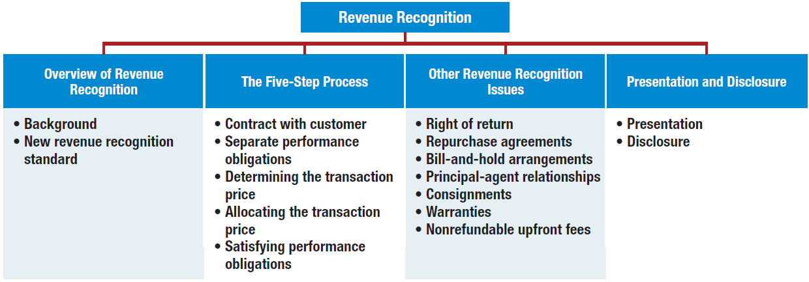
PREVIEW OF CHAPTER
18
Intermediate Accounting
15th Edition (Update)
Kieso Weygandt Warfield

Slide 3
18
Revenue Recognition
LEARNING OBJECTIVES
After studying this chapter, you should be able to:
Understand revenue recognition issues.
Identify the five steps in the revenue recognition process.
Identify the contract with customers.
Identify the separate performance obligations in the contract.
Determine the transaction price.
Allocate the transaction price to the separate performance obligations.
Recognize revenue when the company satisfies its performance obligation.
Identify other revenue recognition issues.
Describe presentation and disclosure regarding revenue.

Slide 4
Overview of Revenue Recognition
Revenue recognition is a top fraud risk and regardless of the accounting rules followed (GAAP or IFRS), the risk or errors and inaccuracies in revenue reporting is significant.
In 2013, the FASB and IASB issued a converged standard on revenue recognition entitled Revenue from Contracts with Customers.
LO 1

Slide 5
Overview of Revenue Recognition
New Revenue Recognition Standard
Revenue from Contracts with Customers, adopts an asset-liability approach. Companies:
Account for revenue based on the asset or liability arising from contracts with customers.
Are required to analyze contracts with customers
Contracts indicate terms and measurement of consideration.
Without contracts, companies cannot know whether promises will be met.
LO 1

Slide 6
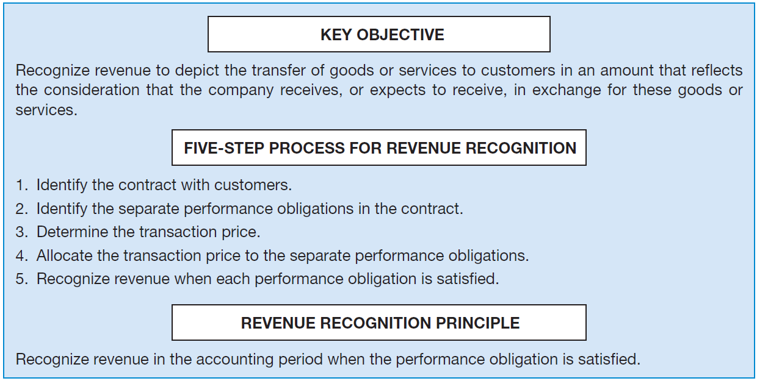
New Revenue Recognition Standard
ILLUSTRATION 18-1 Key Concepts of Revenue Recognition
Performance Obligation is Satisfied
LO 1

Slide 7
18
Revenue Recognition
LEARNING OBJECTIVES
After studying this chapter, you should be able to:
Understand revenue recognition issues.
Identify the five steps in the revenue recognition process.
Identify the contract with customers.
Identify the separate performance obligations in the contract.
Determine the transaction price.
Allocate the transaction price to the separate performance obligations.
Recognize revenue when the company satisfies its performance obligation.
Identify other revenue recognition issues.
Describe presentation and disclosure regarding revenue.

Slide 8
The Five-Step Process
Assume that Boeing Corporation signs a contract to sell airplanes to Delta Air Lines for $100 million.
ILLUSTRATION 18-2
Five Steps of Revenue Recognition
Step 1: Identify the contract
with customers.
A contract is an agreement between two parties
that creates enforceable rights or obligations. In
this case, Boeing has signed a contract to deliver
airplanes to Delta.
Step 2: Identify the separate performance obligations in the contract.
A Boeing has only one performance obligation—to deliver airplanes to Delta. If Boeing also agreed to maintain the planes, a separate performance obligation is recorded for this promise.
LO 2

Slide 9
The Five-Step Process
ILLUSTRATION 18-2 Five Steps of Revenue Recognition
Step 3: Determine the transaction
price.
Transaction price is the amount of consideration
that a company expects to receive from a customer in exchange for transferring a good or service. In this case, the transaction price is
straightforward—it is $100 million.
Step 4: Allocate the transaction price to the separate
performance obligations.
In this case, Boeing has only one performance
obligation—to deliver airplanes to Delta.
LO 2

Slide 10
The Five-Step Process
ILLUSTRATION 18-2 Five Steps of Revenue Recognition
Step 5: Recognize revenue when
each performance obligation
is satisfied.
Boeing recognizes revenue of $100 million for the
sale of the airplanes to Delta when it satisfies its
performance obligation—the delivery of the
airplanes to Delta.
LO 2

Slide 11
18
Revenue Recognition
LEARNING OBJECTIVES
After studying this chapter, you should be able to:
Understand revenue recognition issues.
Identify the five steps in the revenue recognition process.
Identify the contract with customers.
Identify the separate performance obligations in the contract.
Determine the transaction price.
Allocate the transaction price to the separate performance obligations.
Recognize revenue when the company satisfies its performance obligation.
Identify other revenue recognition issues.
Describe presentation and disclosure regarding revenue.

Slide 12
Identify Contract with Customers—Step 1
Contract:
Agreement between two or more parties that creates enforceable rights or obligations.
Can be
written,
oral, or
implied from customary business practice.
Company applies the revenue guidance to a contract according to the following criteria in Illustration 18-3.
LO 3

Slide 13
Contract with Customers—Step 1
ILLUSTRATION 18-3 Contract Criteria for Revenue Guidance
Apply Revenue Guidance to Contracts If:
Disregard Revenue Guidance to Contracts If:
The contract has commercial substance;
The parties to the contract have approved the contract and are committed to perform their respective obligations;
The company can identify each party’s rights regarding the goods or services to be transferred; and
The company can identify the payment terms for the goods and services to be transferred.
The contract is wholly unperformed, and
Each party can unilaterally terminate the contract without compensation.
LO 3

Slide 14
Contract with Customers—Step 1
Basic Accounting
Revenue cannot be recognized until a contract exists.
Company obtains rights to receive consideration and assumes obligations to transfer goods or services.
Rights and performance obligations gives rise to an (net) asset or (net) liability.
Contract asset = Rights received > Performance obligation
Contract liability = Rights received < Performance obligation
LO 3

Slide 15
Basic Accounting
ILLUSTRATION 18-4
Basic Revenue Transaction
CONTRACTS AND RECOGNITION
Facts: On March 1, 2014, Margo Company enters into a contract to transfer a product to Soon Yoon on July 31, 2014. The contract is structured such that Soon Yoon is required to pay the full contract price of $5,000 on August 31, 2014.The cost of the goods transferred is $3,000. Margo delivers the product to Soon Yoon on July 31, 2014.
Question: What journal entries should Margo Company make in regards to this contract in 2014?
The journal entry to record the sale and related cost of goods sold is as follows.
July 31, 2014
Accounts Receivable 5,000
Sales Revenue 5,000
Cost of Goods Sold 3,000
Inventory 3,000
LO 3

Slide 16
Basic Accounting
ILLUSTRATION 18-4
Basic Revenue Transaction
CONTRACTS AND RECOGNITION
Facts: On March 1, 2014, Margo Company enters into a contract to transfer a product to Soon Yoon on July 31, 2014. The contract is structured such that Soon Yoon is required to pay the full contract price of $5,000 on August 31, 2014.The cost of the goods transferred is $3,000. Margo delivers the product to Soon Yoon on July 31, 2014.
Question: What journal entries should Margo Company make in regards to this contract in 2014?
Margo makes the following entry to record the receipt of cash on August 31, 2014.
August 31, 2014
Cash 5,000
Accounts Receivable 5,000
LO 3

Slide 17
Contract with Customers—Step 1
Contract Modifications
Change in contract terms while it is ongoing.
Companies determine
whether a new contract (and performance obligations) results or
whether it is a modification of the existing contract.
LO 3

Slide 18
Contract Modifications
Separate Performance Obligation
Accounts for as a new contract if both of the following conditions are satisfied:
Promised goods or services are distinct (i.e., company sells them separately and they are not interdependent with other goods and services), and
The company has the right to receive an amount of consideration that reflects the standalone selling price of the promised goods or services.
LO 3

Slide 19
Separate Performance Obligation
For example, Crandall Co. has a contract to sell 100 products to a customer for $10,000 ($100 per product) at various points in time over a six-month period. After 60 products have been delivered, Crandall modifies the contract by promising to deliver 20 more products for an additional $1,900, or $95 per product (which is the standalone selling price of the products at the time of the contract modification). Crandall regularly sells the products separately.
Given a new contract, Crandall recognizes an additional:
Original contract [(100 units - 60 units) x $100] = $4,000
New product (20 units x $95) = 1,900
Total revenue $5,900
LO 3

Slide 20
Contract Modifications
Prospective Modification
Company should
Account for effect of change in period of change as well as future periods if change affects both.
Not change previously reported results.
LO 3

Slide 21
Prospective Modification
For Crandall, the amount recognized as revenue for each of the remaining products would be a blended price of $98.33, computed as shown in Illustration 18-5.
Products not delivered under original contract
($100 x $40) = $4,000
Products to be delivered under contract
modification ($95 x 20) = 1,900
Total remaining revenue $5,900
Revenue per remaining unit ($5,900 ÷ 60) = $98.33
LO 3

Slide 22
Prospective Modification
Under the prospective approach, a blended price ($98.33) is used for sales in the periods after the modification.
ILLUSTRATION 18-6
Comparison of Contract Modification Approaches
LO 3

Slide 23
18
Revenue Recognition
LEARNING OBJECTIVES
After studying this chapter, you should be able to:
Understand revenue recognition issues.
Identify the five steps in the revenue recognition process.
Identify the contract with customers.
Identify the separate performance obligations in the contract.
Determine the transaction price.
Allocate the transaction price to the separate performance obligations.
Recognize revenue when the company satisfies its performance obligation.
Identify other revenue recognition issues.
Describe presentation and disclosure regarding revenue.

Slide 24
Separate Performance Obligations—Step 2
Revenue Recognition Situations
Illustration 18-7
Type of Transaction
Sale of product
from inventory
Rendering a service
Permitting use of an asset
Sale of asset other than inventory
Description of Revenue
Revenue from sales
Revenue from fees or services
Revenue from interest, rents, and royalties
Gain or loss on disposition
Timing of Revenue Recognition
Date of sale (date of delivery)
Services performed and billable
As time passes or assets are used
Date of sale or trade-in
LO 4

Slide 25
Separate Performance Obligations—Step 2
To determine whether a company has to account for multiple performance obligations, it evaluates a second condition.
Whether the product is distinct within the contract.
If performance obligation is not highly dependent on, or interrelated with, other promises in the contract, then each performance obligation should be accounted for separately.
If each of these services is interdependent and interrelated, these services are combined and reported as one performance obligation.
LO 4

Slide 26
Performance Obligations—Step 2
ILLUSTRATION 18-8 Identifying Performance Obligations
SoftTech Inc. licenses customer-relationship software to Lopez Company. In addition to providing the software itself, SoftTech promises to provide consulting services by extensively customizing the software to Lopez’s information technology environment, for a total consideration of $600,000. In this case, SoftTech is providing a significant service by integrating the goods and services (the license and the consulting service) into one combined item for which Lopez has contracted. In addition, the software is significantly customized by SoftTech in accordance with specifications negotiated by Lopez. Do these facts describe a single or separate performance obligation?
The license and the consulting services are distinct but interdependent, and therefore should be accounted for as one performance obligation.
LO 4

Slide 27
Performance Obligations—Step 2
ILLUSTRATION 18-8 Identifying Performance Obligations
Chen Computer Inc. manufactures and sells computers that include a warranty to make good on any defect in its computers for 120 days (often referred to as an assurance warranty). In addition, it sells separately an extended warranty, which provides protection from defects for three years beyond the 120 days (often referred to as a service warranty). In this case, two performance obligations exist, one related to the sale of the computer and the assurance warranty, and the other to the extended warranty (service
warranty).
The sale of the computer and related assurance warranty are one performance obligation as they are interdependent and interrelated with each other. However, the extended warranty is separately sold and is not interdependent.
LO 4

Slide 28
18
Revenue Recognition
LEARNING OBJECTIVES
After studying this chapter, you should be able to:
Understand revenue recognition issues.
Identify the five steps in the revenue recognition process.
Identify the contract with customers.
Identify the separate performance obligations in the contract.
Determine the transaction price.
Allocate the transaction price to the separate performance obligations.
Recognize revenue when the company satisfies its performance obligation.
Identify other revenue recognition issues.
Describe presentation and disclosure regarding revenue.

Slide 29
Determining Transaction Price—Step 3
Transaction price
Amount of consideration that company expects to receive from a customer.
In a contract is often easily determined because customer agrees to pay a fixed amount.
Other contracts, companies must consider:
Variable consideration
Time value of money
Noncash consideration
Consideration paid or payable to the customer
LO 5

Slide 30
Determining Transaction Price—Step 3
Variable Consideration
Price dependent on future events.
May include discounts, rebates, credits, performance bonuses, or royalties.
Companies estimate amount of revenue to recognize.
Expected value
Most likely amount
LO 5

Slide 31
Determining Transaction Price—Step 3
ILLUSTRATION 18-9 Estimating Variable Consideration
Expected Value: Probability-weighted amount in a range of possible consideration amounts.
May be appropriate if a company has a large number of contracts with similar characteristics.
Can be based on a limited number of discrete outcomes and probabilities.
Most Likely Amount: The single most likely amount in a range of possible consideration outcomes.
May be appropriate if the contract has only two possible outcomes.
LO 5

Slide 32
Variable Consideration
ILLUSTRATION 18-10
Transaction Price
ESTIMATING VARIABLE CONSIDERATION
Facts: Peabody Construction Company enters into a contract with a customer to build a warehouse for $100,000, with a performance bonus of $50,000 that will be paid based on the timing of completion. The amount of the performance bonus decreases by 10% per week for every week beyond the agreed-upon completion date. The contract requirements are similar to contracts that Peabody has performed previously, and management believes that such experience is predictive for this contract. Management estimates that there is a 60% probability that the contract will be completed by the agreed-upon completion date, a 30% probability that it will be completed 1 week late, and only a 10% probability that it will be completed 2 weeks late.
Question: How should Peabody account for this revenue arrangement?
LO 5

Slide 33
Variable Consideration
ILLUSTRATION 18-10
Transaction Price
Question: How should Peabody account for this revenue arrangement?
Management has concluded that the probability-weighted method is the most predictive approach:
60% chance of $150,000 = $ 90,000
30% chance of $145,000 = 43,500
10% chance of $140,000 = 14,000
$147,500
Most likely outcome, if management believes they will meet the deadline and receive the $50,000 bonus, the total transaction price would be?
$150,000 (the outcome with 60% probability)
LO 5

Slide 34
Variable Consideration
Only allocate variable consideration if it is reasonably assured that it will be entitled to the amount.
Companies only recognizes variable consideration if
they have experience with similar contracts and are able to estimate the cumulative amount of revenue, and
based on experience, they do not expect a significant reversal of revenue previously recognized.
If these criteria are not met, revenue recognition is constrained.
LO 5

Slide 35
Determining Transaction Price—Step 3
Time Value of Money
When contract (sales transaction) involves a significant financing component.
Interest accrued on consideration to be paid over time.
Fair value determined either by measuring the consideration received or by discounting the payment using an imputed interest rate.
Company reports as interest expense or interest revenue.
LO 5

Slide 36
Time Value of Money
ILLUSTRATION 18-12
Transaction Price -Extended Payment Terms
EXTENDED PAYMENT TERMS
Facts: On July 1, 2014, SEK Company sold goods to Grant Company for $900,000 in exchange for a 4-year, zero-interest-bearing note with a face amount of $1,416,163. The goods have an inventory cost on SEK’s books of $590,000.
Questions: (a) How much revenue should SEK Company record on July 1, 2014? (b) How much revenue should it report related to this transaction on December 31, 2014?
Entry to record SEK’s sale to Grant Company on July 1, 2014, is as follows.
Notes Receivable 1,416,163
Sales Revenue 900,000
Discount on Notes Receivable 516,163
Cost of Goods Sold 590,000
Inventory 590,000
LO 5

Slide 37
Time Value of Money
ILLUSTRATION 18-12
Transaction Price -Extended Payment Terms
EXTENDED PAYMENT TERMS
Facts: On July 1, 2014, SEK Company sold goods to Grant Company for $900,000 in exchange for a 4-year, zero-interest-bearing note with a face amount of $1,416,163. The goods have an inventory cost on SEK’s books of $590,000.
Questions: (a) How much revenue should SEK Company record on July 1, 2014? (b) How much revenue should it report related to this transaction on December 31, 2014?
Entry to record interest revenue at the end of the year, December 31, 2014.
Discount on Notes Receivable 54,000
Interest Revenue (12% x ½ x $900,000) 54,000
Companies are not required to reflect the time value of money if the time period for payment is less than a year.
LO 5

Slide 38
Determining Transaction Price—Step 3
Noncash Consideration
Goods, services, or other noncash consideration.
Companies sometimes receive contributions (e.g., donations and gifts).
Customers sometimes contribute goods or services, such as equipment or labor, as consideration for goods provided or services performed.
Companies generally recognize revenue on the basis of the fair value of what is received.
LO 5

Slide 39
Determining Transaction Price—Step 3
Consideration Paid or Payable to Customers
May include discounts, volume rebates, coupons, free products, or services.
In general, these elements reduce the consideration received and the revenue to be recognized.
LO 5

Slide 40
Consideration Paid or Payable
ILLUSTRATION 18-13
Transaction Price – Volume Discount
VOLUME DISCOUNT
Facts: Sansung Company offers its customers a 3% volume discount if they purchase at least $2 million of its product during the calendar year. On March 31, 2014, Sansung has made sales of $700,000 to Artic Co. In the previous 2 years, Sansung sold over $3,000,000 to Artic in the period April 1 to December 31.
Questions: How much revenue should Sansung recognize for the first 3 months of 2014?
Sansung makes the following entry on March 31, 2014.
Accounts Receivable 679,000
Sales Revenue 679,000
Sansung should reduce its revenue by $21,000 ($700,000 x 3%) because it is
probable that it will provide this rebate.
LO 5

Slide 41
Consideration Paid or Payable
ILLUSTRATION 18-13
Transaction Price – Volume Discount
Questions: How much revenue should Sansung recognize for the first 3 months of 2014?
Assuming Sansung’s customer meets the discount threshold, Sansung makes the following entry.
Cash 679,000
Accounts Receivable 679,000
If Sansung’s customer fails to meet the discount threshold, Sansung makes the following entry upon payment.
Cash 700,000
Accounts Receivable 679,000
Sales Discounts Forfeited 21,000
LO 5

Slide 42
18
Revenue Recognition
LEARNING OBJECTIVES
After studying this chapter, you should be able to:
Understand revenue recognition issues.
Identify the five steps in the revenue recognition process.
Identify the contract with customers.
Identify the separate performance obligations in the contract.
Determine the transaction price.
Allocate the transaction price to the separate performance obligations.
Recognize revenue when the company satisfies its performance obligation.
Identify other revenue recognition issues.
Describe presentation and disclosure regarding revenue.

Slide 43
Allocating Transaction Price to Separate Performance Obligations—Step 4
Based on their relative fair values.
Best measure of fair value is what the company could sell the good or service for on a standalone basis.
If not available, companies should use their best estimate of what the good or service might sell for as a standalone unit.
LO 6

Slide 44
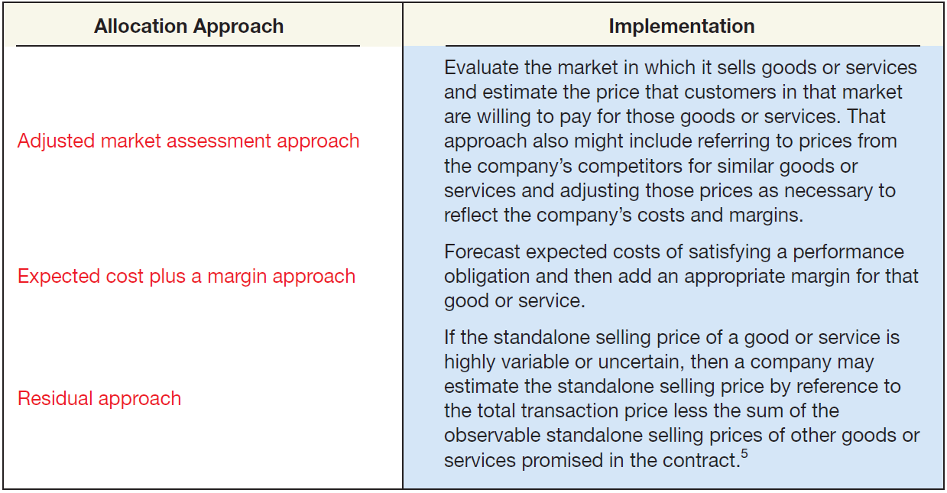
Allocating Transaction Price to Separate Performance Obligations—Step 4
ILLUSTRATION 18-14
Transaction Price
Allocation
LO 6

Slide 45
18
Revenue Recognition
LEARNING OBJECTIVES
After studying this chapter, you should be able to:
Understand revenue recognition issues.
Identify the five steps in the revenue recognition process.
Identify the contract with customers.
Identify the separate performance obligations in the contract.
Determine the transaction price.
Allocate the transaction price to the separate performance obligations.
Recognize revenue when the company satisfies its performance obligation.
Identify other revenue recognition issues.
Describe presentation and disclosure regarding revenue.

Slide 46
Recognizing Revenue When (or as) Each
Performance Obligation Is Satisfied-Step 5
Company satisfies its performance obligation when the customer obtains control of the good or service.
Change in Control Indicators
Company has a right to payment for asset.
Company has transferred legal title to asset.
Company has transferred physical possession of asset.
Customer has significant risks and rewards of ownership.
Customer has accepted the asset.
LO 7

Slide 47
Recognizing Revenue When (or as) Each
Performance Obligation Is Satisfied-Step 5
Recognizing revenue from a performance obligation over time
Measure progress toward completion
Method for measuring progress should depict transfer of control from company to customer.
Most common are cost-to-cost and units-of-delivery methods.
Objective of methods is to measure extent of progress in terms of costs, units, or value added.
LO 7

Slide 48
Recognizing Revenue When (or as) Each
Performance Obligation Is Satisfied-Step 5
Step in Process
Identify the contract with customers.
Description
A contract is an agreement that creates enforceable rights or obligations.
Implementation
A company applies the revenue guidance to contracts with customers and must determine if new performance obligations are created by a contract modification.
ILLUSTRATION 18-20
Summary of the
Five-Step Revenue
Recognition Process
LO 7

Slide 49
Recognizing Revenue When (or as) Each
Performance Obligation Is Satisfied-Step 5
Step in Process
Identify the separate performance obligations in the contract
Description
A performance obligation is a promise in a contract to provide a product or service to a customer.
A performance obligation exists if the customer can benefit from the good or service on its own or together with other readily available resources.
Implementation
A contract may be comprised of multiple performance obligations.
Accounting is based on evaluation of whether the product or service is distinct within the contract.
If each of the goods or services is distinct, but is interdependent and interrelated, these goods and services are combined and reported as one performance obligation.
ILLUSTRATION 18-20
Summary of the
Five-Step Revenue
Recognition Process
LO 7

Slide 50
Recognizing Revenue When (or as) Each
Performance Obligation Is Satisfied-Step 5
Step in Process
Determine the transaction price.
Description
Transaction price is the amount of consideration that a company expects to receive from a customer in exchange for transferring goods and services.
Implementation
In determining the transaction price, companies must consider the following factors:
variable consideration,
time value of money,
noncash consideration, and
consideration paid or payable to customer.
ILLUSTRATION 18-20
Summary of the
Five-Step Revenue
Recognition Process
LO 7

Slide 51
Recognizing Revenue When (or as) Each
Performance Obligation Is Satisfied-Step 5
Step in Process
Allocate the transaction price to the separate performance obligation.
Description
If more than one performance obligation exists, allocate the transaction price based on relative fair values.
Implementation
The best measure of fair value is what the good service could be sold for on a standalone basis (standalone selling price). Estimates of standalone selling price can be based on
adjusted market assessment,
expected cost plus a margin approach, or
a residual approach.
ILLUSTRATION 18-20
Summary of the
Five-Step Revenue
Recognition Process
LO 7

Slide 52
Recognizing Revenue When (or as) Each
Performance Obligation Is Satisfied-Step 5
Step in Process
Recognize revenue when each performance obligation is satisfied.
Description
A company satisfies its performance obligation when the customer obtains control of the good or service.
Implementation
Companies satisfy performance obligations either at a point in time or over a period of time. Companies recognize revenue over a period of time if
the customer controls the asset as it is created or the company does not have an alternative use for the asset, and
the company has a right to payment.
ILLUSTRATION 18-20
Summary of the
Five-Step Revenue
Recognition Process
LO 7

Slide 53
18
Revenue Recognition
LEARNING OBJECTIVES
After studying this chapter, you should be able to:
Understand revenue recognition issues.
Identify the five steps in the revenue recognition process.
Identify the contract with customers.
Identify the separate performance obligations in the contract.
Determine the transaction price.
Allocate the transaction price to the separate performance obligations.
Recognize revenue when the company satisfies its performance obligation.
Identify other revenue recognition issues.
Describe presentation and disclosure regarding revenue.

Slide 54
Other Revenue Recognition Issues
Right of return
Consignments
Repurchase agreements
Warranties
Bill and hold
Nonrefundable upfront fees
Principal-agent relationships
LO 8

Slide 55
Right of Return
Right of return is granted for product for various reasons (e.g., dissatisfaction with product).
Company returning the product receives any combination of the following.
Full or partial refund of any consideration paid.
Credit that can be applied against amounts owed, or that will be owed, to the seller.
Another product in exchange.
LO 8

Slide 56
Right of Return
ILLUSTRATION 18-21
Recognition—Right of Return
RIGHT OF RETURN
Facts: Venden Company sells 100 products for $100 each to Amaya Inc. for cash. Venden allows Amaya to return any unused product within 30 days and receive a full refund. The cost of each product is $60. To determine the transaction price, Venden decides that the approach that is most predictive of the amount of consideration to which it will be entitled is the most likely amount. Using the most likely amount, Venden estimates that:
Three (3) products will be returned.
The costs of recovering the products will be immaterial.
The returned products are expected to be resold at a profit.
Question: How should Venden record this sale?
LO 8

Slide 57
Right of Return
ILLUSTRATION 18-21
Recognition—Right of Return
Question: How should Venden record this sale?
Venden records the sale as follows with the expectation that three products will be returned:
Cash 10,000
Sales Revenue [$9,700 x ($100 x 97)] 9,700
Refund Liability ($100 x 3) 300
Venden records the cost of goods sold with the following entry.
Cost of Goods Sold 5,820
Estimated Inventory Returns ($60 x 3) 180
Inventory 6,000
LO 8

Slide 58
Right of Return
ILLUSTRATION 18-21
Recognition—Right of Return
Question: How should Venden record this sale?
When a return occurs, Venden records the following entries.
Refund Liability (2 x $100) 200
Accounts Receivable (or Accounts Payable) 200
Returned Inventory (2 x $60) 120
Estimated Inventory Returns 120
Companies record the returned asset in a separate account from inventory to provide transparency.
LO 8

Slide 59
Repurchase Agreements
Transfer control of (sell) an asset to a customer but have an obligation or right to repurchase.
If obligation or right to repurchase is for an amount greater than or equal to selling price, then transaction is a financing transaction.
LO 8

Slide 60
Repurchase Agreements
ILLUSTRATION 18-22
Recognition—Repurchase Agreement
REPURCHASE AGREEMENT
Facts: Morgan Inc., an equipment dealer, sells equipment on January 1, 2014, to Lane Company for $100,000. It agrees to repurchase this equipment on December 31, 2015, for a price of $121,000.
Question: How should Morgan Inc. record this transaction?
Assuming an interest rate of 10 percent is imputed from the agreement, Morgan makes the following entry to record the financing on January 1, 2014.
Cash 100,000
Liability to Lane Company 100,000
LO 8

Slide 61
Repurchase Agreements
ILLUSTRATION 18-22
Recognition—Repurchase Agreement
Question: How should Morgan Inc. record this transaction?
Morgan Inc. records interest on December 31, 2014, as follows.
Interest Expense 10,000
Liability to Lane Company ($100,000 x 10%) 10,000
Morgan Inc. records interest and retirement of its liability to Lane Company on December 31, 2014, as follows.
Interest Expense 11,000
Liability to Lane Company ($110,000 x 10%) 11,000
Liability to Lane Company 121,000
Cash ($100,000 + $10,000 + $11,000) 121,000
LO 8

Slide 62
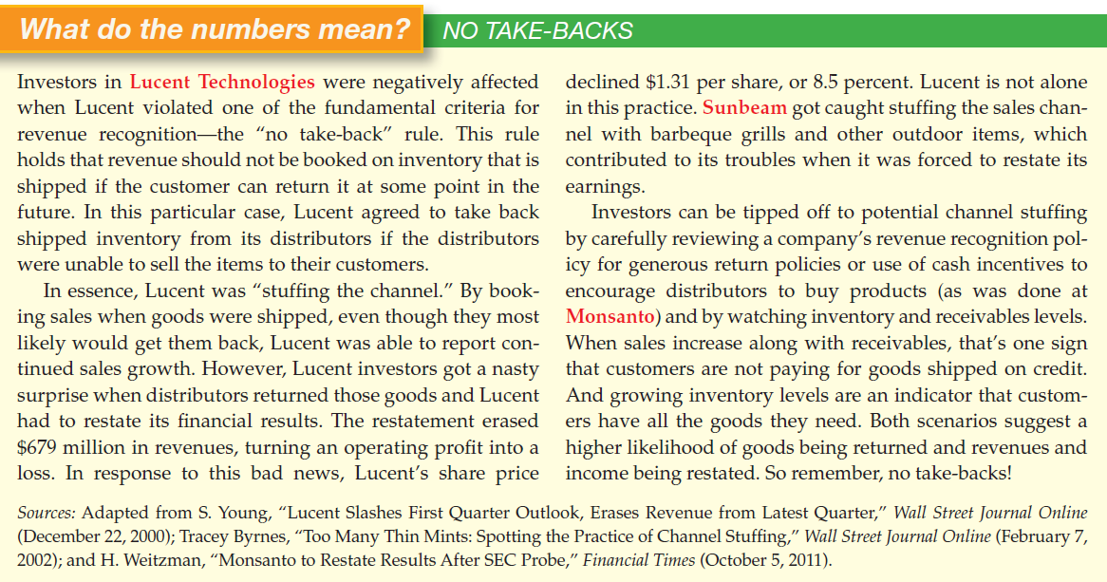
LO 8

Slide 63
Bill-and-Hold Arrangements
Contract under which an entity bills a customer for a product but the entity retains physical possession of the product until a point in time in the future.
Result when buyer is not yet ready to take delivery but does take title and accepts billing.
LO 8

Slide 64
Bill-and-Hold Arrangements
ILLUSTRATION 18-23
Recognition—Bill and Hold
BILL AND HOLD
Facts: Butler Company sells $450,000 (cost $280,000) of fireplaces on March 1, 2014, to a local coffee shop, Baristo, which is planning to expand its locations around the city. Under the agreement, Baristo asks Butler to retain these fireplaces in its warehouses until the new coffee shops that will house the fireplaces are ready. Title passes to Baristo at the time the agreement is signed.
Question: When should Butler recognize the revenue from this bill-and-hold arrangement?
Butler determines when it has satisfied its performance obligation to transfer a product by evaluating when Baristo obtains control of that product.
LO 8

Slide 65
Bill-and-Hold Arrangements
ILLUSTRATION 18-23
Recognition—Bill and Hold
Question: When should Butler recognize the revenue from this bill-and-hold arrangement?
For Baristo to have obtained control of a product in a bill-and-hold arrangement, all of the following criteria should be met:
(a) The reason for the bill-and-hold arrangement must be substantive.
(b) The product must be identified separately as belonging to Baristo.
(c) The product currently must be ready for physical transfer to Baristo.
Butler cannot have the ability to use the product or to direct it to another customer.
In this case, it appears that the above criteria were met, and therefore revenue recognition should be permitted at the time the contract is signed.
LO 8

Slide 66
Bill-and-Hold Arrangements
ILLUSTRATION 18-23
Recognition—Bill and Hold
Question: When should Butler recognize the revenue from this bill-and-hold arrangement?
Butler makes the following entry to record the sale.
Accounts receivable 450,000
Sales Revenue 450,000
Butter makes an entry to record the related cost of goods sold as follows.
Cost of Goods Sold 280,000
Inventory 280,000
LO 8

Slide 67
Principle-Agent Relationships
Agent’s performance obligation is to arrange for principal to provide goods or services to a customer.
Examples:
Travel Company (agent) facilitates booking of cruise for Cruise Company (principal).
Priceline (agent) facilitates sale of various services such as car rentals at Hertz (principal).
Amounts collected on behalf of the principal are not revenue of the agent.
Revenue for agent is amount of commission received.
LO 8

Slide 68
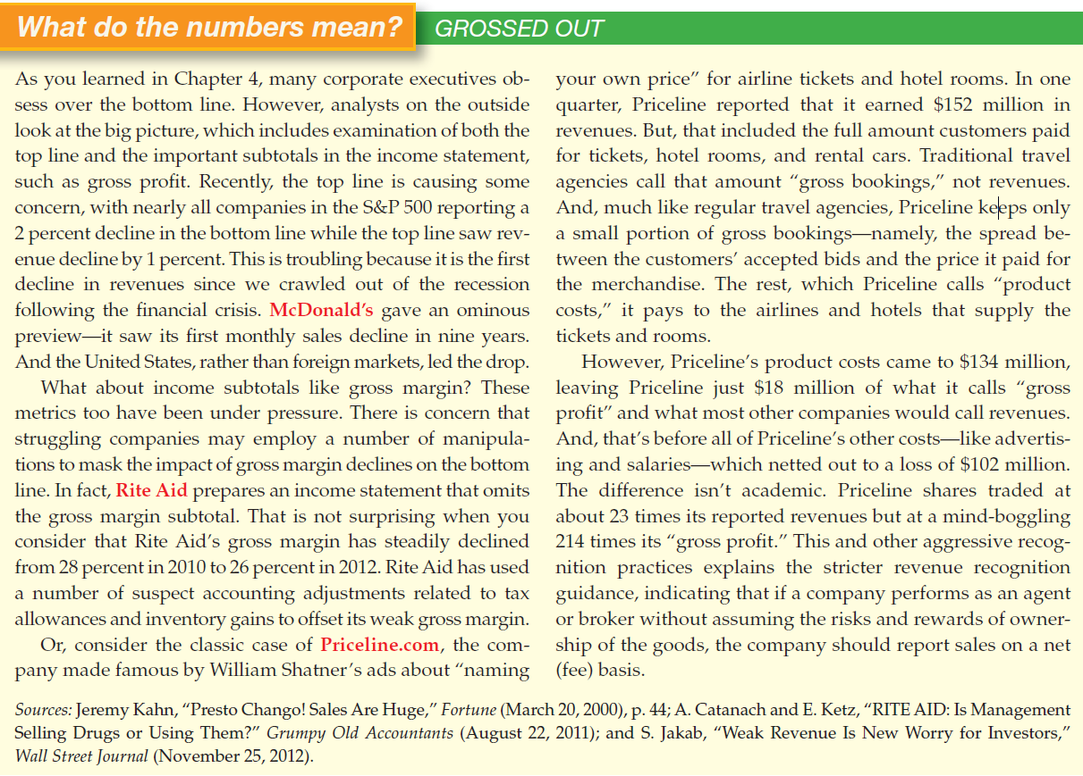
LO 8

Slide 69
Consignments
Manufacturers (or wholesalers) deliver goods but retain title to the goods until they are sold.
Consignor (manufacturer or wholesaler) ships merchandise to the consignee (dealer), who is to act as an agent for the consignor in selling the merchandise.
Consignor makes a profit on the sale.
Carries merchandise as inventory.
Consignee makes a commission on the sale.
LO 8

Slide 70
Consignments
ILLUSTRATION 18-25
Recognition—Sales on Consignment
LO 8

Slide 71
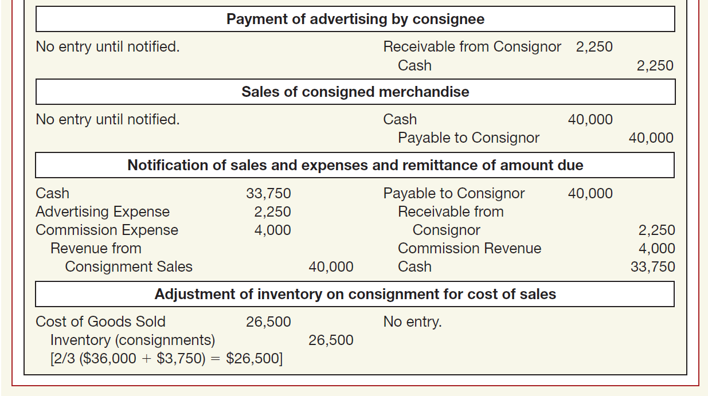
Consignments
ILLUSTRATION 18-25
Recognition—Sales on Consignment
LO 8

Slide 72
Warranties
Two types of warranties to customers:
Product meets agreed-upon specifications in contract at time product is sold.
Warranty is included in sales price (assurance-type warranty).
Not included in sales price of product (service-type warranty).
Recorded as a separate performance obligation.
LO 8

Slide 73
Warranties
ILLUSTRATION 18-26
Performance Obligations and Warranties
WARRANTIES
Facts: Maverick Company sold 1,000 Rollomatics during 2014 at a total price of $6,000,000, with a warranty guarantee that the product was free of any defects. The cost of Rollomatics sold is $4,000,000. The term of the assurance warranty is two years, with an estimated cost of $30,000. In addition, Maverick sold extended warranties related to 400 Rollomatics for 3 years beyond the 2-year period for $12,000.
Question: What are the journal entries that Maverick Company should make in 2014 related to the sale and the related warranties?
LO 8

Slide 74
Warranties
ILLUSTRATION 18-26
Performance Obligations and Warranties
Question: What are the journal entries that Maverick Company should make in 2014 related to the sale and the related warranties?
To record the revenue and liabilities related to the warranties:
Cash ($6,000,000 + $12,000) 6,012,000
Warranty Expense 30,000
Warranty Liability 30,000
Unearned Warranty Revenue 12,000
Sales Revenue 6,000,000
Cost of Goods Sold 4,000,000
Inventory 4,000,000
To reduce inventory and recognize cost of goods sold:
LO 8

Slide 75
Nonrefundable Upfront Fees
Payments from customers before
Delivery of a product
Performance of a service
Generally relate to initiation, activation, or setup of a good or service to be provided or performed in the future.
Most cases, upfront payments are nonrefundable.
Examples include:
Membership fee in a health club
Activation fees for phone, Internet, or cable
LO 8

Slide 76
18
Revenue Recognition
LEARNING OBJECTIVES
After studying this chapter, you should be able to:
Understand revenue recognition issues.
Identify the five steps in the revenue recognition process.
Identify the contract with customers.
Identify the separate performance obligations in the contract.
Determine the transaction price.
Allocate the transaction price to the separate performance obligations.
Recognize revenue when the company satisfies its performance obligation.
Identify other revenue recognition issues.
Describe presentation and disclosure regarding revenue.

Slide 77
Presentation and Disclosure
Presentation
Contract Assets and Liabilities
Contract assets are of two types:
Unconditional rights to receive consideration because company has satisfied its performance obligation.
Conditional rights to receive consideration because company has satisfied one performance obligation but must satisfy another performance obligation before it can bill the customer.
LO 9

Slide 78
Presentation
ILLUSTRATION 18-29
Contract Asset Recognition and Presentation
CONTRACT ASSET
Facts: On January 1, 2014, Finn Company enters into a contract to transfer Product A and Product B to Obermine Co. for $100,000. The contract specifies that payment of Product A will not occur until Product B is also delivered. In other words, payment will not occur until both Product A and Product B are transferred to Obermine. Finn determines that standalone prices are $30,000 for Product A and $70,000 for Product B. Finn delivers Product A to Obermine on February 1, 2014. On March 1, 2014, Finn delivers Product B to Obermine.
Question: What journal entries should Finn Company make in regards to this contract in 2014?
LO 9

Slide 79
Presentation
ILLUSTRATION 18-29
Contract Asset Recognition and Presentation
Question: What journal entries should Finn Company make in regards to this contract in 2014?
On February 1, 2014, Finn records the following entry:
Contract Asset 30,000
Sales Revenue 30,000
On February 1, Finn does not record an accounts receivable because it does not have an unconditional right to receive the $100,000 unless it also transfers Product B to Obermine. When Finn transfers Product B on March 1, 2014, it makes the following entry.
Accounts Receivable 100,000
Contract Asset 30,000
Sales Revenue 70,000
LO 9

Slide 80
Presentation
ILLUSTRATION 18-30
Contract Liability Recognition and Presentation
CONTRACT LIABILITY
Facts: On March 1, 2014, Henly Company enters into a contract to transfer a product to Propel Inc. on July 31, 2014. It is agreed that Propel will pay the full price of $10,000 in advance on April 1, 2014. The contract is noncancelable. Propel, however, does not pay until April 15, 2014, and Henly delivers the product on July 31, 2014. The cost of the product is
$7,500.
Question: What journal entries are required in 2014?
No entry is required on March 1, 2014:
Neither party has performed on the contract.
Neither party has an unconditional right as of March 1, 2014.
LO 9

Slide 81
Presentation
ILLUSTRATION 18-30
Contract Liability Recognition and Presentation
Question: What journal entries are required in 2014?
Henly should make the following entry on April 1, 2014.
Accounts Receivable 10,000
Unearned Sales Revenue 10,000
On receiving the cash on April 15, 2014, Henly records the following entry.
Cash 10,000
Accounts Receivable 10,000
On satisfying the performance obligation on July 31, 2014, Henly records the following entry to record the sale.
Unearned Sales Revenue 10,000
Sales Revenue 10,000
LO 9

Slide 82
Presentation
Costs to Fulfill a Contract
Companies divide fulfillment costs (contract acquisition costs) into two categories:
Those that give rise to an asset.
Those that are expensed as incurred.
LO 9

Slide 83
Presentation
Collectibility
Credit risk that a customer will be unable to pay in accordance with the contract.
Whether a company will get paid is not a consideration in determining revenue recognition.
Amount recognized as revenue is not adjusted for customer credit risk.
LO 9

Slide 84
Disclosure
Companies disclose qualitative and quantitative information about the following:
Contracts with customers
Significant judgments
Assets recognized from costs incurred to fulfill a contract
LO 9

Slide 85
Disclosure
Companies provide a range of disclosures:
Disaggregation of revenue
Reconciliation of contract balances
Remaining performance obligations
Cost to obtain or fulfill contracts
Other qualitative disclosures
Significant judgments and changes in them
Minimum revenue not subject to variable consideration constraint
LO 9

Slide 86
APPENDIX 18A
LONG-TERM CONSTRUCTION CONTRACTS
Revenue Recognition Over Time
Occurs when one of two conditions exist:
Customer controls asset as it is created or enhanced.
Company does not have an alternative use for asset created or enhanced and either
customer receives benefits as company performs the task, or
company has a right to payment and this right is enforceable.
LO 10 Apply the percentage-of-completion method for long-term contracts.

Slide 87
APPENDIX 18A
LONG-TERM CONSTRUCTION CONTRACTS
Revenue Recognition Over Time
One or both criteria are met in long-term construction contract accounting.
Long-term contracts frequently provide that seller (builder) may bill purchaser at intervals.
Examples:
Development of military and commercial aircraft
Weapons delivery systems
Space exploration hardware
LO 10

Slide 88
APPENDIX 18A
LONG-TERM CONSTRUCTION CONTRACTS
Revenue Recognition Over Time
Two Methods of accounting:
Percentage-of-Completion Method
Recognize revenues and gross profits each period based upon the progress of the construction
Buyer and seller have enforceable rights
Completed-Contract Method
Recognize revenues and gross profit only when the contract is completed
LO 10

Slide 89
APPENDIX 18A
LONG-TERM CONSTRUCTION CONTRACTS
Revenue Recognition Over Time
Companies must use Percentage-of-Completion when estimates of progress toward completion, revenues, and costs are reasonably dependable and all the following exist:
Contract specifies enforceable rights regarding goods or services by parties, consideration to be exchanged, and manner and terms of settlement.
Buyer can be expected to satisfy all obligations.
Contractor can be expected to perform the contractual obligations.
LO 10

Slide 90
APPENDIX 18A
LONG-TERM CONSTRUCTION CONTRACTS
Revenue Recognition Over Time
Companies should use the completed-contract method when one of the following conditions applies:
When a company has primarily short-term contracts, or
When a company cannot meet conditions for using the percentage-of-completion method, or
When there are inherent hazards in the contract beyond the normal, recurring business risks.
LO 10

Slide 91
APPENDIX 18A
LONG-TERM CONSTRUCTION CONTRACTS
Percentage-of-Completion Method
Revenue to Recognized Cost-to-Cost Basis
Illustration 18-1A
Illustration 18-2A
Illustration 18-3A
LO 10

Slide 92
APPENDIX 18A
PERCENTAGE-OF-COMPLETION METHOD
Illustration: Hardhat Construction Company has a contract to construct a $4,500,000 bridge at an estimated cost of $4,000,000. The contract is to start in July 2014, and the bridge is to be completed in October 2016. The following data pertain to the construction period.
LO 10

Slide 93
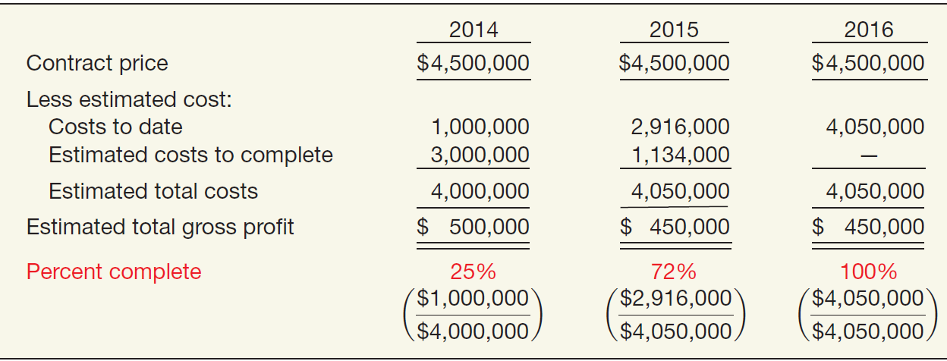
APPENDIX 18A
PERCENTAGE-OF-COMPLETION METHOD
Illustration 18-4A
LO 10

Slide 94
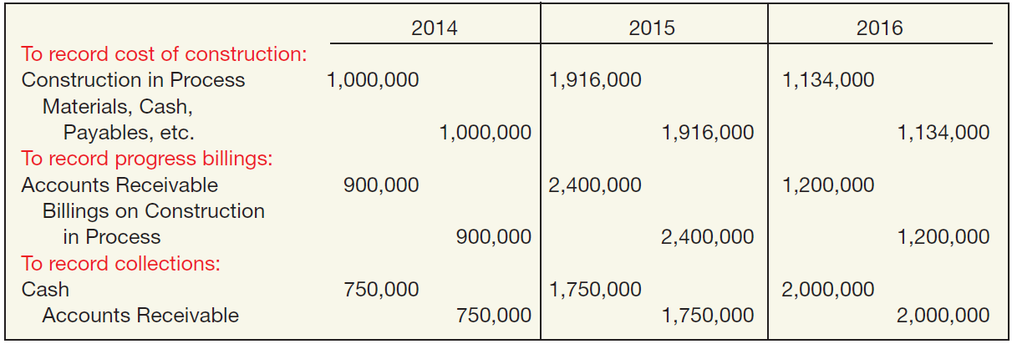
APPENDIX 18A
PERCENTAGE-OF-COMPLETION METHOD
Illustration 18-5A
LO 10

Slide 95
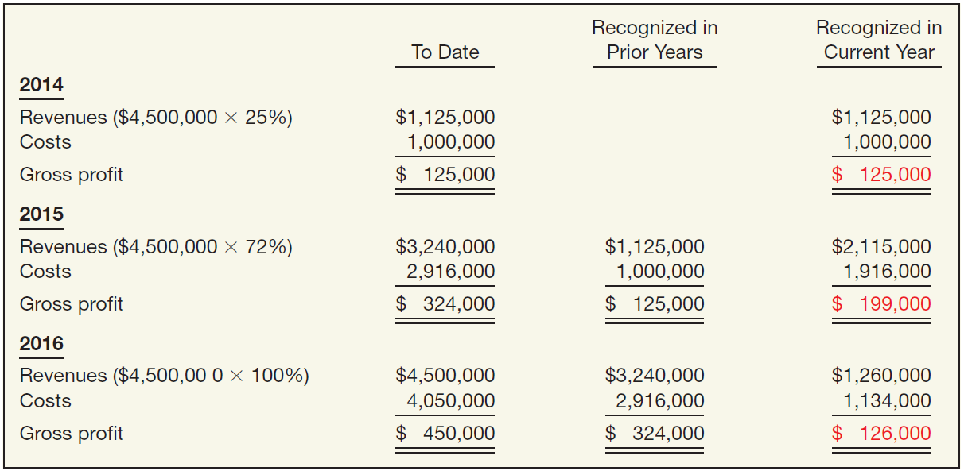
APPENDIX 18A
PERCENTAGE-OF-COMPLETION METHOD
Illustration: Percentage-of-Completion Revenue, Costs, and Gross Profit by Year
Illustration 18-6A
LO 10

Slide 96
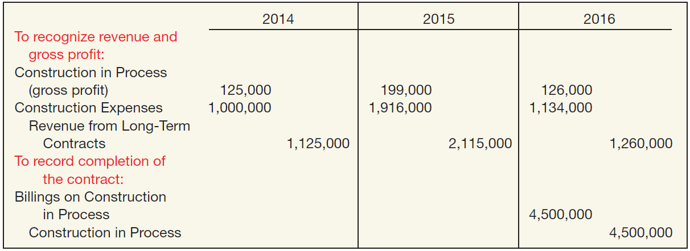
Illustration 18-6A
APPENDIX 18A
PERCENTAGE-OF-COMPLETION METHOD
Illustration 18-7A
LO 10

Slide 97
APPENDIX 18A
PERCENTAGE-OF-COMPLETION METHOD
Illustration: Content of Construction in Process Account—Percentage-of-Completion Method
Illustration 18-8A
LO 10

Slide 98
APPENDIX 18A
PERCENTAGE-OF-COMPLETION METHOD
Financial Statement Presentation—Percentage-of-Completion
Computation of Unbilled Contract Price at 12/31/14
Illustration 18-9A
LO 10

Slide 99
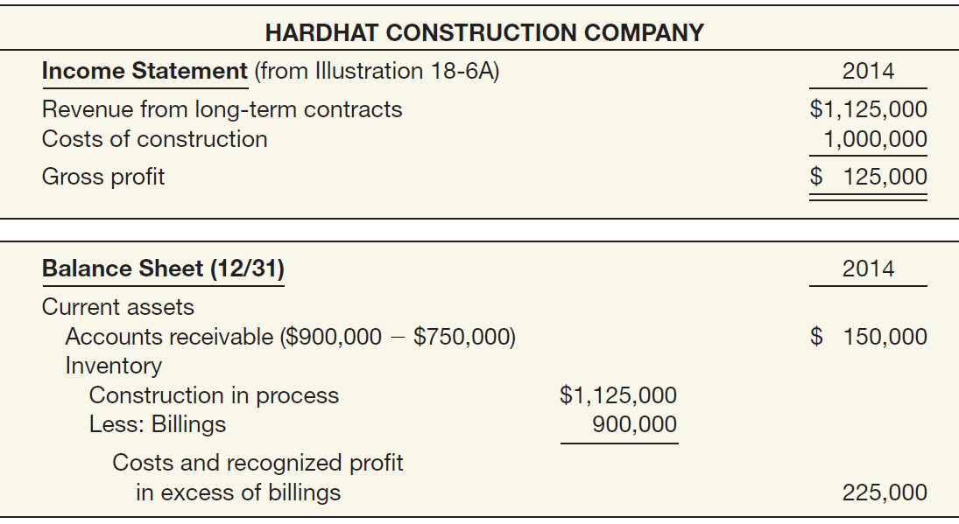
APPENDIX 18A
PERCENTAGE-OF-COMPLETION METHOD
Financial Statement Presentation—Percentage-of-Completion Method 2014
Illustration 18-10A
LO 10

Slide 100
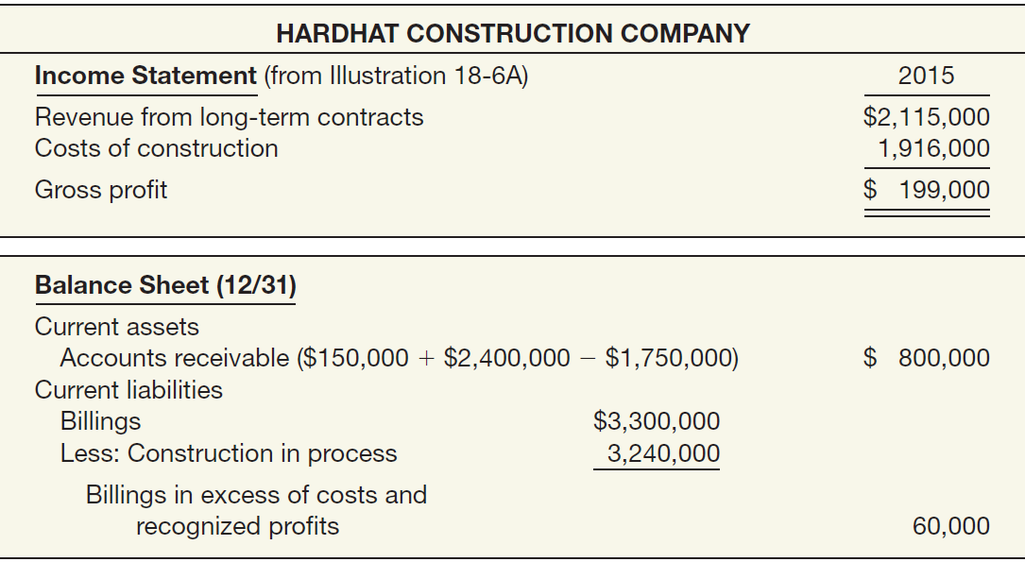
APPENDIX 18A
PERCENTAGE-OF-COMPLETION METHOD
Financial Statement Presentation—Percentage-of-Completion Method 2015
Illustration 18-11A
LO 10

Slide 101
APPENDIX 18A
PERCENTAGE-OF-COMPLETION METHOD
Illustration: Casper Construction Co.
A) Prepare the journal entries for 2014, 2015, and 2016.
LO 10

Slide 102
APPENDIX 18A
PERCENTAGE-OF-COMPLETION METHOD
Illustration:
Advance slide in presentation mode to reveal answers.
LO 10

Slide 103
APPENDIX 18A
PERCENTAGE-OF-COMPLETION METHOD
Illustration:
LO 10

Slide 104
APPENDIX 18A
PERCENTAGE-OF-COMPLETION METHOD
Illustration:
LO 10

Slide 105
APPENDIX 18A
COMPLETED-CONTRACT METHOD
Completed Contract Method
Companies recognize revenue and gross profit only at point of sale—that is, when the contract is completed.
Under this method, companies accumulate costs of long-term contracts in process, but they make no interim charges or credits to income statement accounts for revenues, costs, or gross profit.
LO 11 Apply the completed-contract method for long-term contracts.

Slide 106
APPENDIX 18A
COMPLETED-CONTRACT METHOD
Illustration:
LO 11

Slide 107
APPENDIX 18A
COMPLETED-CONTRACT METHOD
Illustration:
LO 11

Slide 108
APPENDIX 18A
LONG-TERM CONSTRUCTION CONTRACTS
Long-Term Contract Losses
Loss in Current Period on a Profitable Contract
Percentage-of-completion method only, the estimated cost increase requires a current-period adjustment of gross profit recognized in prior periods.
Loss on an Unprofitable Contract
Under both percentage-of-completion and completed-contract methods, the company must recognize in the current period the entire expected contract loss.
LO 12 Identify the proper accounting for losses on long-term contracts.

Slide 109
APPENDIX 18A
LONG-TERM CONTRACT LOSSES
Illustration: Loss on Profitable Contract
Casper Construction Co.
b) Prepare the journal entries to record revenue and expense for 2014, 2015, and 2016 assuming the estimated cost to complete at the end of 2015 was $215,436 instead of $170,100.
Advance slide in presentation mode to reveal answers.
LO 12

Slide 110
APPENDIX 18A
LONG-TERM CONTRACT LOSSES
Illustration: Loss on Profitable Contract
LO 12

Slide 111
APPENDIX 18A
LONG-TERM CONTRACT LOSSES
Illustration: Loss on Profitable Contract
LO 12

Slide 112
APPENDIX 18A
LONG-TERM CONTRACT LOSSES
Illustration: Loss on Unprofitable Contract
Casper Construction Co.
Prepare the journal entries for 2014, 2015, and 2016 assuming the estimated cost to complete at the end of 2015 was $246,038 instead of $170,100.
LO 12

Slide 113
APPENDIX 18A
LONG-TERM CONTRACT LOSSES
Illustration: Loss on Unprofitable Contract
$675,000 – 683,438 = (8,438) cumulative loss
LO 12

Slide 114
APPENDIX 18A
LONG-TERM CONTRACT LOSSES
Illustration: Loss on Unprofitable Contract
LO 12

Slide 115
APPENDIX 18A
LONG-TERM CONTRACT LOSSES
Illustration: Loss on Unprofitable Contract
For the Completed-Contract method, companies would recognize the following loss :
LO 12

Slide 116
APPENDIX 18B
REVENUE RECOGNITION FOR FRANCHISES
Franchises
Four types of franchising arrangements have evolved:
Manufacturer-retailer
Manufacturer-wholesaler
Service sponsor-retailer
Wholesaler-retailer
LO 13 Explain the revenue recognition for franchises.

Slide 117
APPENDIX 18B
REVENUE RECOGNITION FOR FRANCHISES
Franchises
Fastest-growing category is service sponsor-retailer:
Soft ice cream/frozen yogurt stores (Tastee Freeze, TCBY, Dairy Queen)
Food drive-ins (McDonald’s, KFC, Burger King)
Restaurants (TGI Friday’s, Pizza Hut, Denny’s)
Motels (Holiday Inn, Marriott, Best Western)
Auto rentals (Avis, Hertz, National)
Others (H & R Block, Meineke Mufflers, 7-Eleven Stores)
LO 13

Slide 118
APPENDIX 18B
REVENUE RECOGNITION FOR FRANCHISES
Franchises
Two sources of revenue:
Sale of initial franchises and related assets or services, and
Continuing fees based on the operations of franchises.
LO 13

Slide 119
APPENDIX 18B
REVENUE RECOGNITION FOR FRANCHISES
Franchises
The franchisor normally provides the franchisee with:
Assistance in site selection
Evaluation of potential income
Supervision of construction activity
Assistance in the acquisition of signs, fixtures, and equipment
Bookkeeping and advisory services
Employee and management training
Quality control
Advertising and promotion
LO 13

Slide 120
APPENDIX 18B
REVENUE RECOGNITION FOR FRANCHISES
Franchise Accounting
Performance obligations relate to:
Right to open a business
Use of trade name or other intellectual property of the franchisor
Continuing services, such as marketing help, training, and in some cases supplying inventory and inventory management
LO 13

Slide 121
APPENDIX 18B
REVENUE RECOGNITION FOR FRANCHISES
Franchise Accounting
Franchisors commonly charge an initial franchise fee and continuing franchise fees:
Initial franchise fee (payment for establishing the relationship and providing some initial services)
Continuing franchise fees received
In return for continuing rights granted by the agreement
For providing management training, advertising and promotion, legal assistance, and other support
LO 13

Slide 122
APPENDIX 18B
REVENUE RECOGNITION FOR FRANCHISES
Facts: Tum’s Pizza Inc. enters into a franchise agreement on November 1, 2014, giving Food Fight Corp. the right to operate as a franchisee of Tum’s Pizza for 5 years. Tum’s charges Food Fight an initial franchise fee of $50,000 for the right to operate as a franchisee. Of this amount, $20,000 is payable when Food Fight signs the agreement, and the balance is payable in five annual payments of $6,000 each on December 31. Food Fight also promises to pay ongoing royalty payments of 1% of its annual sales (payable each January 31 of the following year) and is obliged to purchase products from Tum’s at its current standalone selling prices at the time of purchase. The credit rating of Food Fight indicates that money can be borrowed at 8%. The present value of an ordinary annuity of five annual receipts of $6,000 each discounted at 8% is $23,957. The discount of $6,043 represents the interest revenue to be accrued by Tum’s over the payment period.
LO 13

Slide 123
APPENDIX 18B
REVENUE RECOGNITION FOR FRANCHISES
Identify the performance obligations and the point in time when the performance obligations are satisfied and revenue is recognized.
Rights to the trade name, market area, and proprietary know-how for 5 years are not individually distinct.
Each one is not sold separately and cannot be used with other goods or services that are readily available to the franchisee.
Combined rights give rise to a single performance obligation.
Tum’s satisfies performance obligation at point in time when Food Fight obtains control of the rights.
LO 13

Slide 124
APPENDIX 18B
REVENUE RECOGNITION FOR FRANCHISES
Identify the performance obligations and the point in time when the performance obligations are satisfied and revenue is recognized.
Training services and equipment are distinct because similar services and equipment are sold separately.
Tum’s satisfies those performance obligations when it transfers the services and equipment to Food Fight.
Tum’s cannot recognize revenue for the royalty payments because it is not reasonably assured to be entitled to those royalty amounts.
Tum’s recognizes revenue for the royalties when (or as) the uncertainty is resolved.
LO 13

Slide 125
APPENDIX 18B
REVENUE RECOGNITION FOR FRANCHISES
Consider the following for allocation of the transaction price.
Training is completed in November and December 2014, the equipment is installed in December 2014, and Food Fight holds a grand opening on January 2, 2015.
LO 13

Slide 126
APPENDIX 18B
REVENUE RECOGNITION FOR FRANCHISES
On November 1, 2014, Tum’s signs the agreement and receives upfront payment and note.
Cash 20,000
Notes Receivable 30,000
Discount on Notes Receivable 6,043
Unearned Franchise Revenue 20,000
Unearned Service Revenue (training) 9,957
Unearned Sales Revenue (equipment) 14,000
LO 13

Slide 127
APPENDIX 18B
REVENUE RECOGNITION FOR FRANCHISES
On January 2, 2015, franchise opens. Tum’s satisfies the performance obligations related to the franchise rights, training, and equipment.
Unearned Franchise Revenue 20,000
Franchise Revenue 20,000
Unearned Service Revenue (training) 9,957
Service Revenue (training) 9,957
Unearned Sales Revenue (equipment) 14,000
Sales Revenue 14,000
Cost of Goods Sold 10,000
Inventory 10,000
LO 13

Slide 128
APPENDIX 18B
REVENUE RECOGNITION FOR FRANCHISES
Recognition of Franchise Rights Revenue Over Time
Depending on the economic substance of the rights, the franchisor may be providing access to the right rather than transferring control of the franchise rights.
In this case, the franchise revenue is recognized over time, rather than at a point in time.
LO 13

Slide 129
APPENDIX 18B
FRANCHISE REVENUE OVER TIME
Facts: Tech Solvers Corp. is a franchisor and provides a range of computing services (hardware/software installation, repairs, data backup, device syncing, and network solutions) on popular Apple and PC devices. Each franchise agreement gives a franchisee the right to open a Tech Solvers store and sell Tech Solvers’ products and services in the area for 5 years. Under the contract, Tech Solvers also provides the franchisee with a number of services to support and enhance the franchise brand, including
advising and consulting on the operations of the store;
communicating new hardware and software developments, and service techniques;
providing business and training manuals; and
advertising programs and training.
LO 13

Slide 130
APPENDIX 18B
FRANCHISE REVENUE OVER TIME
Facts: As an almost entirely service operation (all parts and other supplies are purchased as needed by customers), Tech Solvers provides few upfront services to franchisees. Instead, the franchisee recruits service technicians, who are given Tech Solvers’ training materials (online manuals and tutorials), which are updated for technology changes, on a monthly basis at a minimum. Tech Solvers enters into a franchise agreement on December 15, 2014, giving a franchisee the rights to operate a Tech Solvers franchise in eastern Indiana for 5 years. Tech Solvers charges an initial franchise fee of $5,000 for the right to operate as a franchisee, payable upon signing the contract. Tech Solvers also receives ongoing royalty payments of 7% of the franchisee’s annual sales (payable each January 15 of the following year).
LO 13

Slide 131
APPENDIX 18B
FRANCHISE REVENUE OVER TIME
Identify the performance obligations and the point in time when the performance obligations are satisfied and revenue is recognized.
Rights to the trade name, market area, and proprietary know-how for 5 years are not individually distinct.
Each one is not sold separately and cannot be used with other goods or services that are readily available to the franchisee.
Licensed rights and the ongoing training materials are a single performance obligation.
Tech Solvers is providing access to the rights and must continue (over time) to perform updates and services.
LO 13

Slide 132
APPENDIX 18B
FRANCHISE REVENUE OVER TIME
Identify the performance obligations and the point in time when the performance obligations are satisfied and revenue is recognized.
Tech Solvers cannot recognize revenue for the royalty payments
Not reasonably assured to be entitled to those revenue-based royalty amounts.
Payments represent variable consideration.
Recognize revenue for royalties when (or as) uncertainty is resolved.
LO 13

Slide 133
APPENDIX 18B
FRANCHISE REVENUE OVER TIME
Franchise agreement signed and receipt of upfront payment and note, December 15, 2014:
Cash 5,000
Unearned Franchise Revenue 5,000
Franchise begins operations in January 2015 and records $85,000 of revenue for the year ended December 31, 2015.
Unearned Franchise Revenue 1,000
Franchise Revenue ($5,000 ÷ 5) 1,000
LO 13

Slide 134
Copyright
Copyright © 2015 John Wiley & Sons, Inc. All rights reserved. Reproduction or translation of this work beyond that permitted in Section 117 of the 1976 United States Copyright Act without the express written permission of the copyright owner is unlawful. Request for further information should be addressed to the Permissions Department, John Wiley & Sons, Inc. The purchaser may make back-up copies for his/her own use only and not for distribution or resale. The Publisher assumes no responsibility for errors, omissions, or damages, caused by the use of these programs or from the use of the information contained herein.

